Slide 1
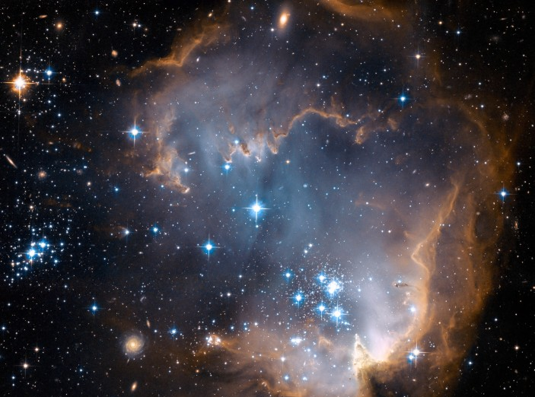



Predicting the Zodi: Hubble Space Telescope Images Need Better Zodiacal Light Model
By Megan Miller
Mentors: Dr. Rogier Windhorst, Rosalia O’Brien
ASU/NASA Space Grant

Slide 2
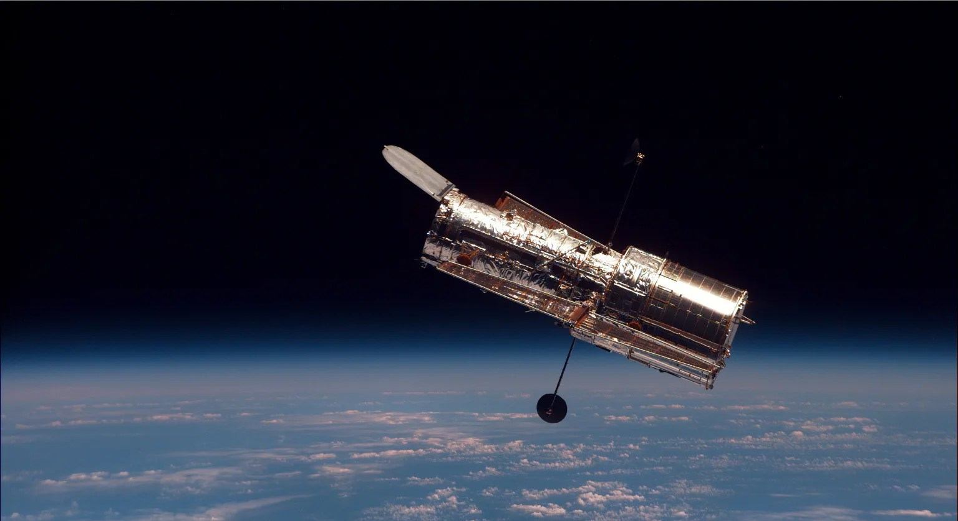
CONTENTS OF THIS TEMPLATE
wfc3ir
wfc3uvis
F225W F275W F336W F390W F438W F475W F555W F606W F625W F775W F850LP F814W
F098M F105W F110W F125W F140W F160W
acswfc
F435W F475W F555W F606W F625W F775W F814W F850LP
Hubble
Space Telescope

Slide 3
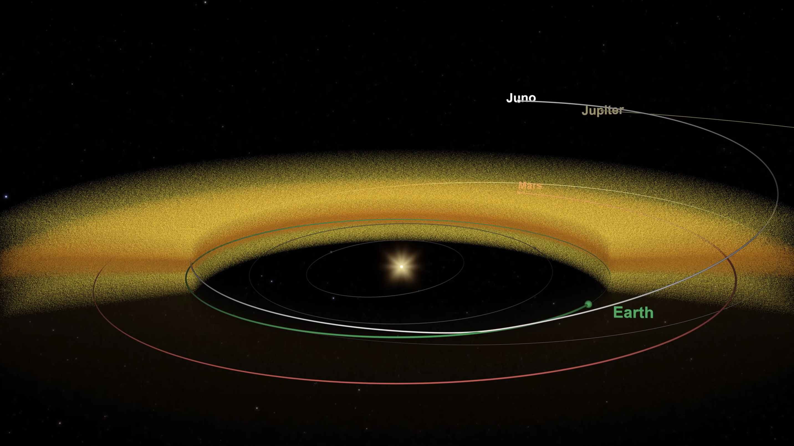
Zodiacal Light
01

Slide 4
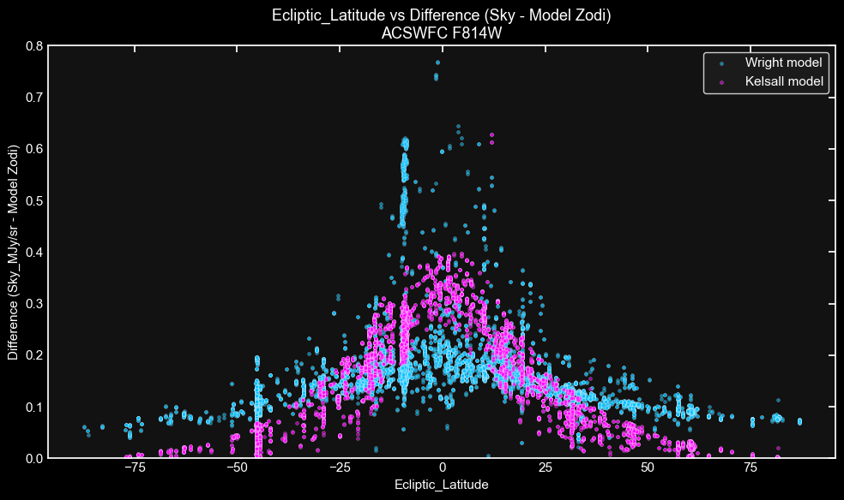
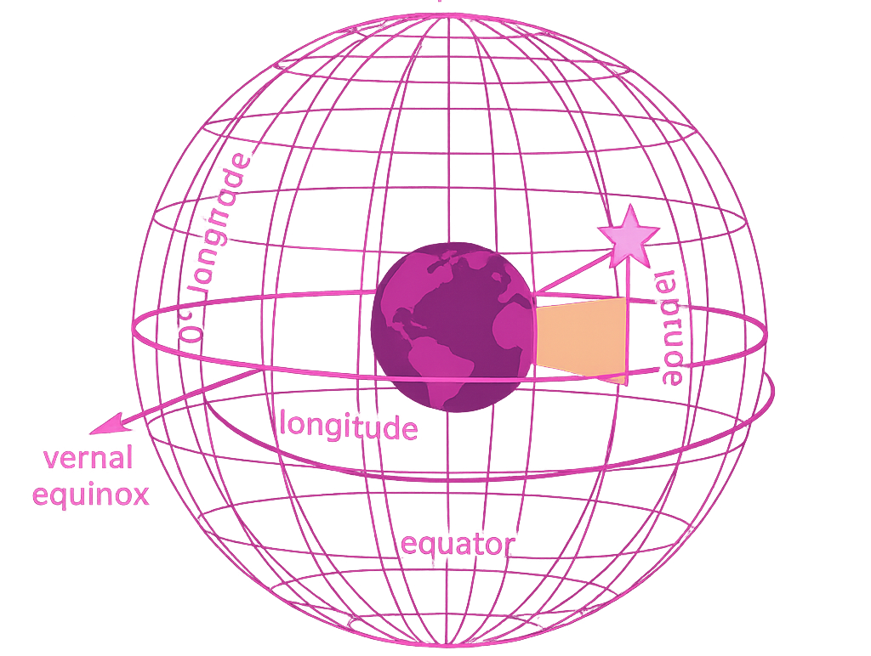
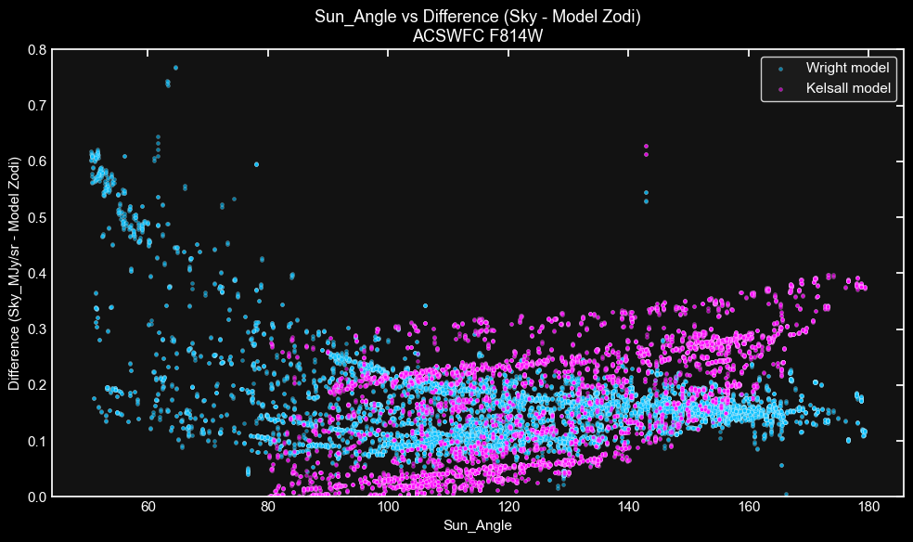

{{
The Ecliptic
Latitude
Ecliptic Latitude
The Sun
Angle

Slide 5
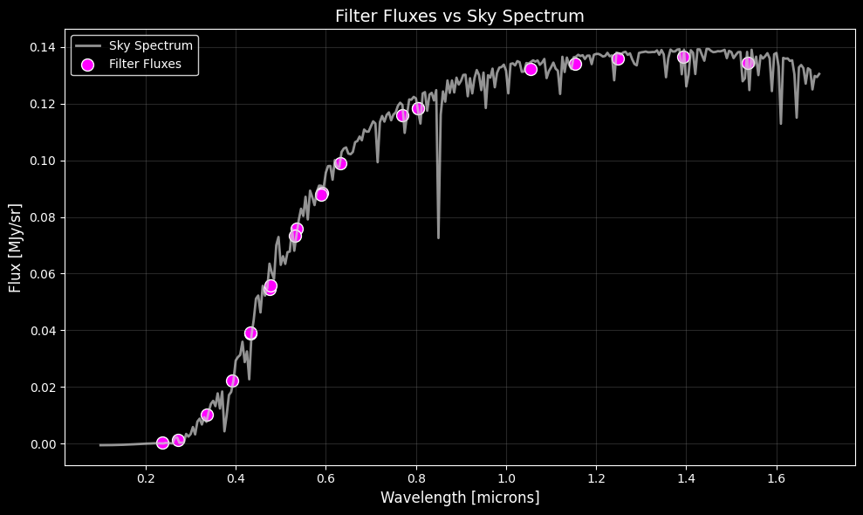

Slide 6
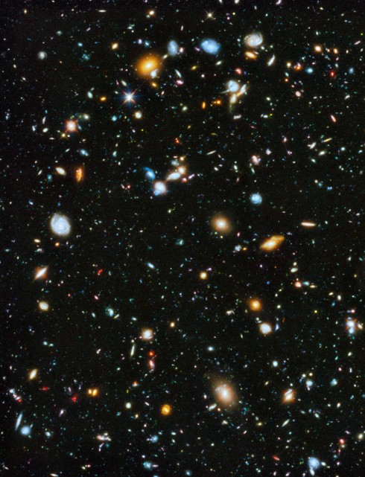
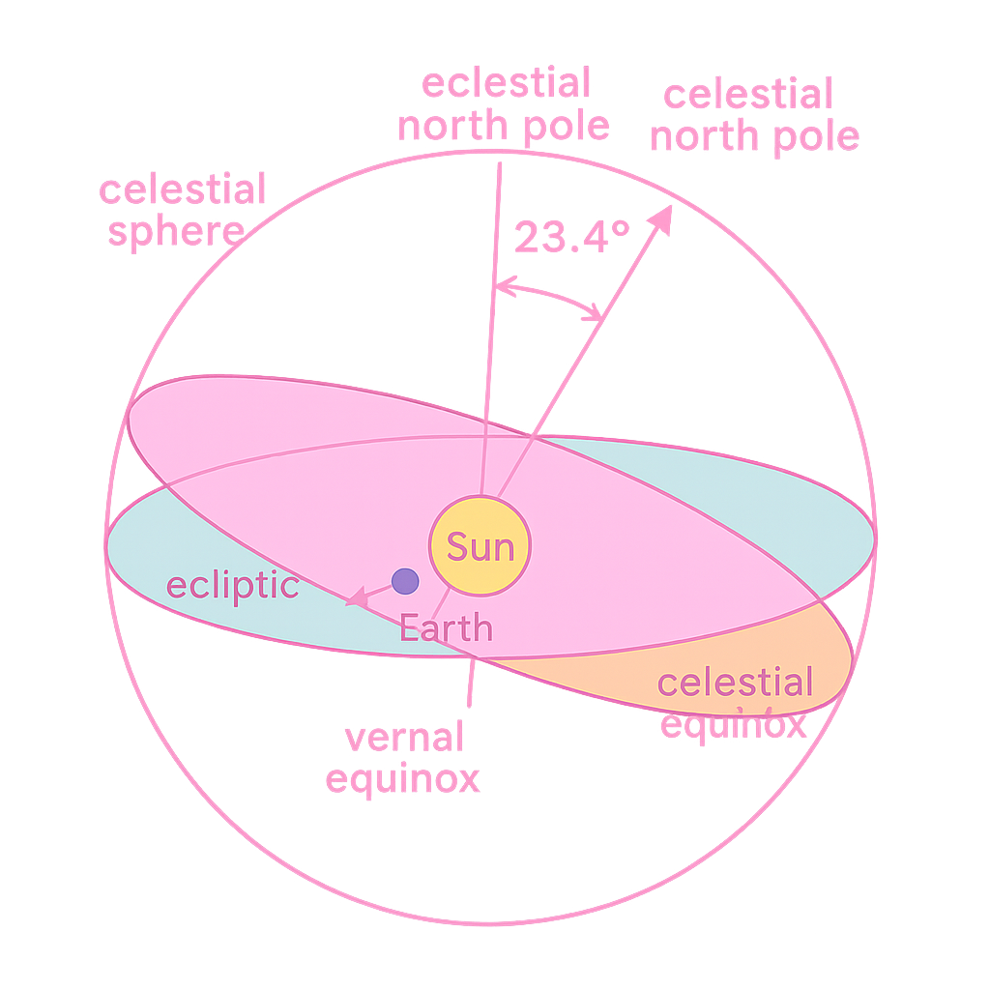
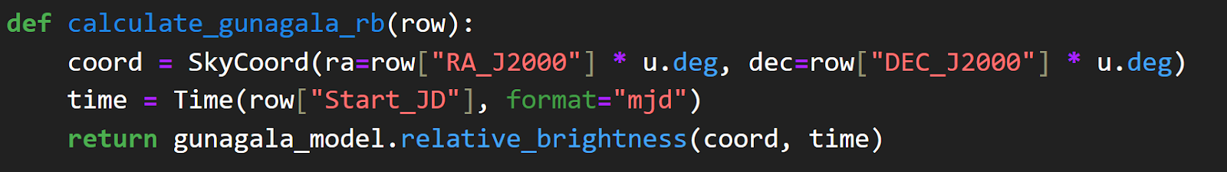
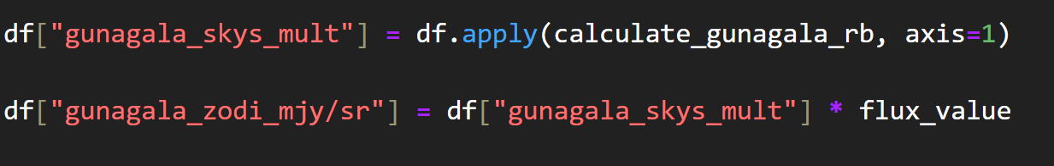
ecliptic .

Slide 7
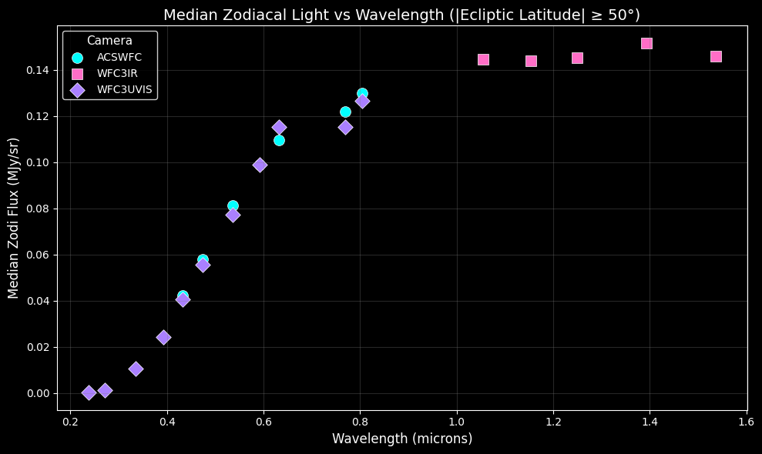

Slide 8
Acknowledgments Dr. Rogier Windhorst, Rosalia O’Brien Desiree Crawl, Dr. Thomas Sharp ASU/NASA Space Grant SkySurf Team School of Earth and Space Exploration

Slide 9
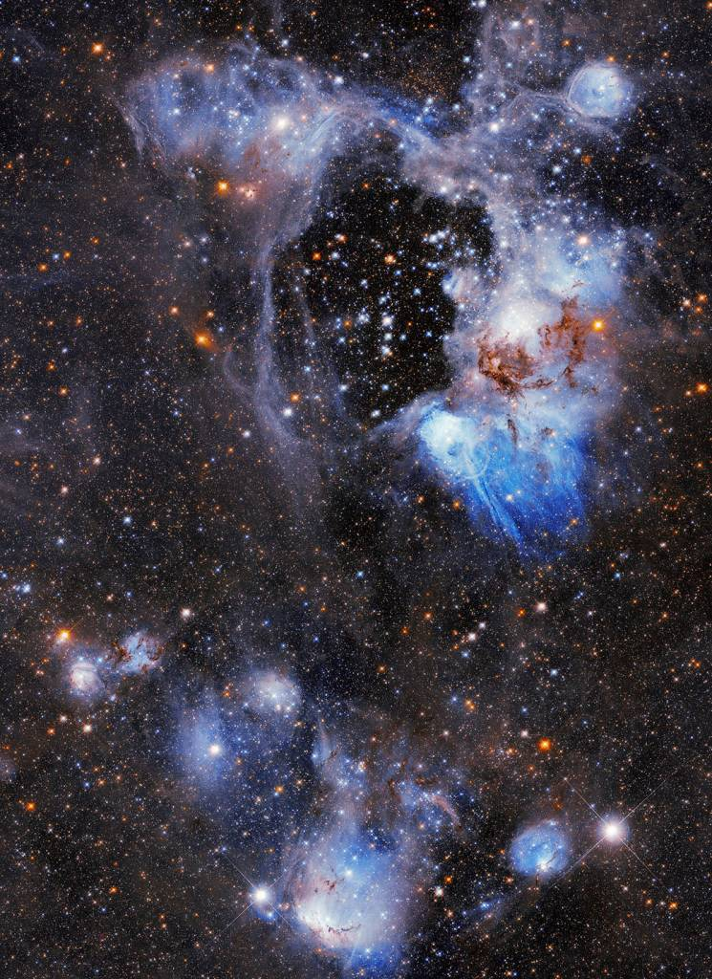

Questions?
Predicting the Zodi: Hubble Space Telescope Images Need Better Zodiacal Light Model
By Megan Miller
Mentors: Dr. Rogier Windhorst, Roselia O’Brien

